Slide 1
Rock, Paper, Scissors
Bailey Korfhage
Ryan Fox
Caitlin Sizemore

Slide 2
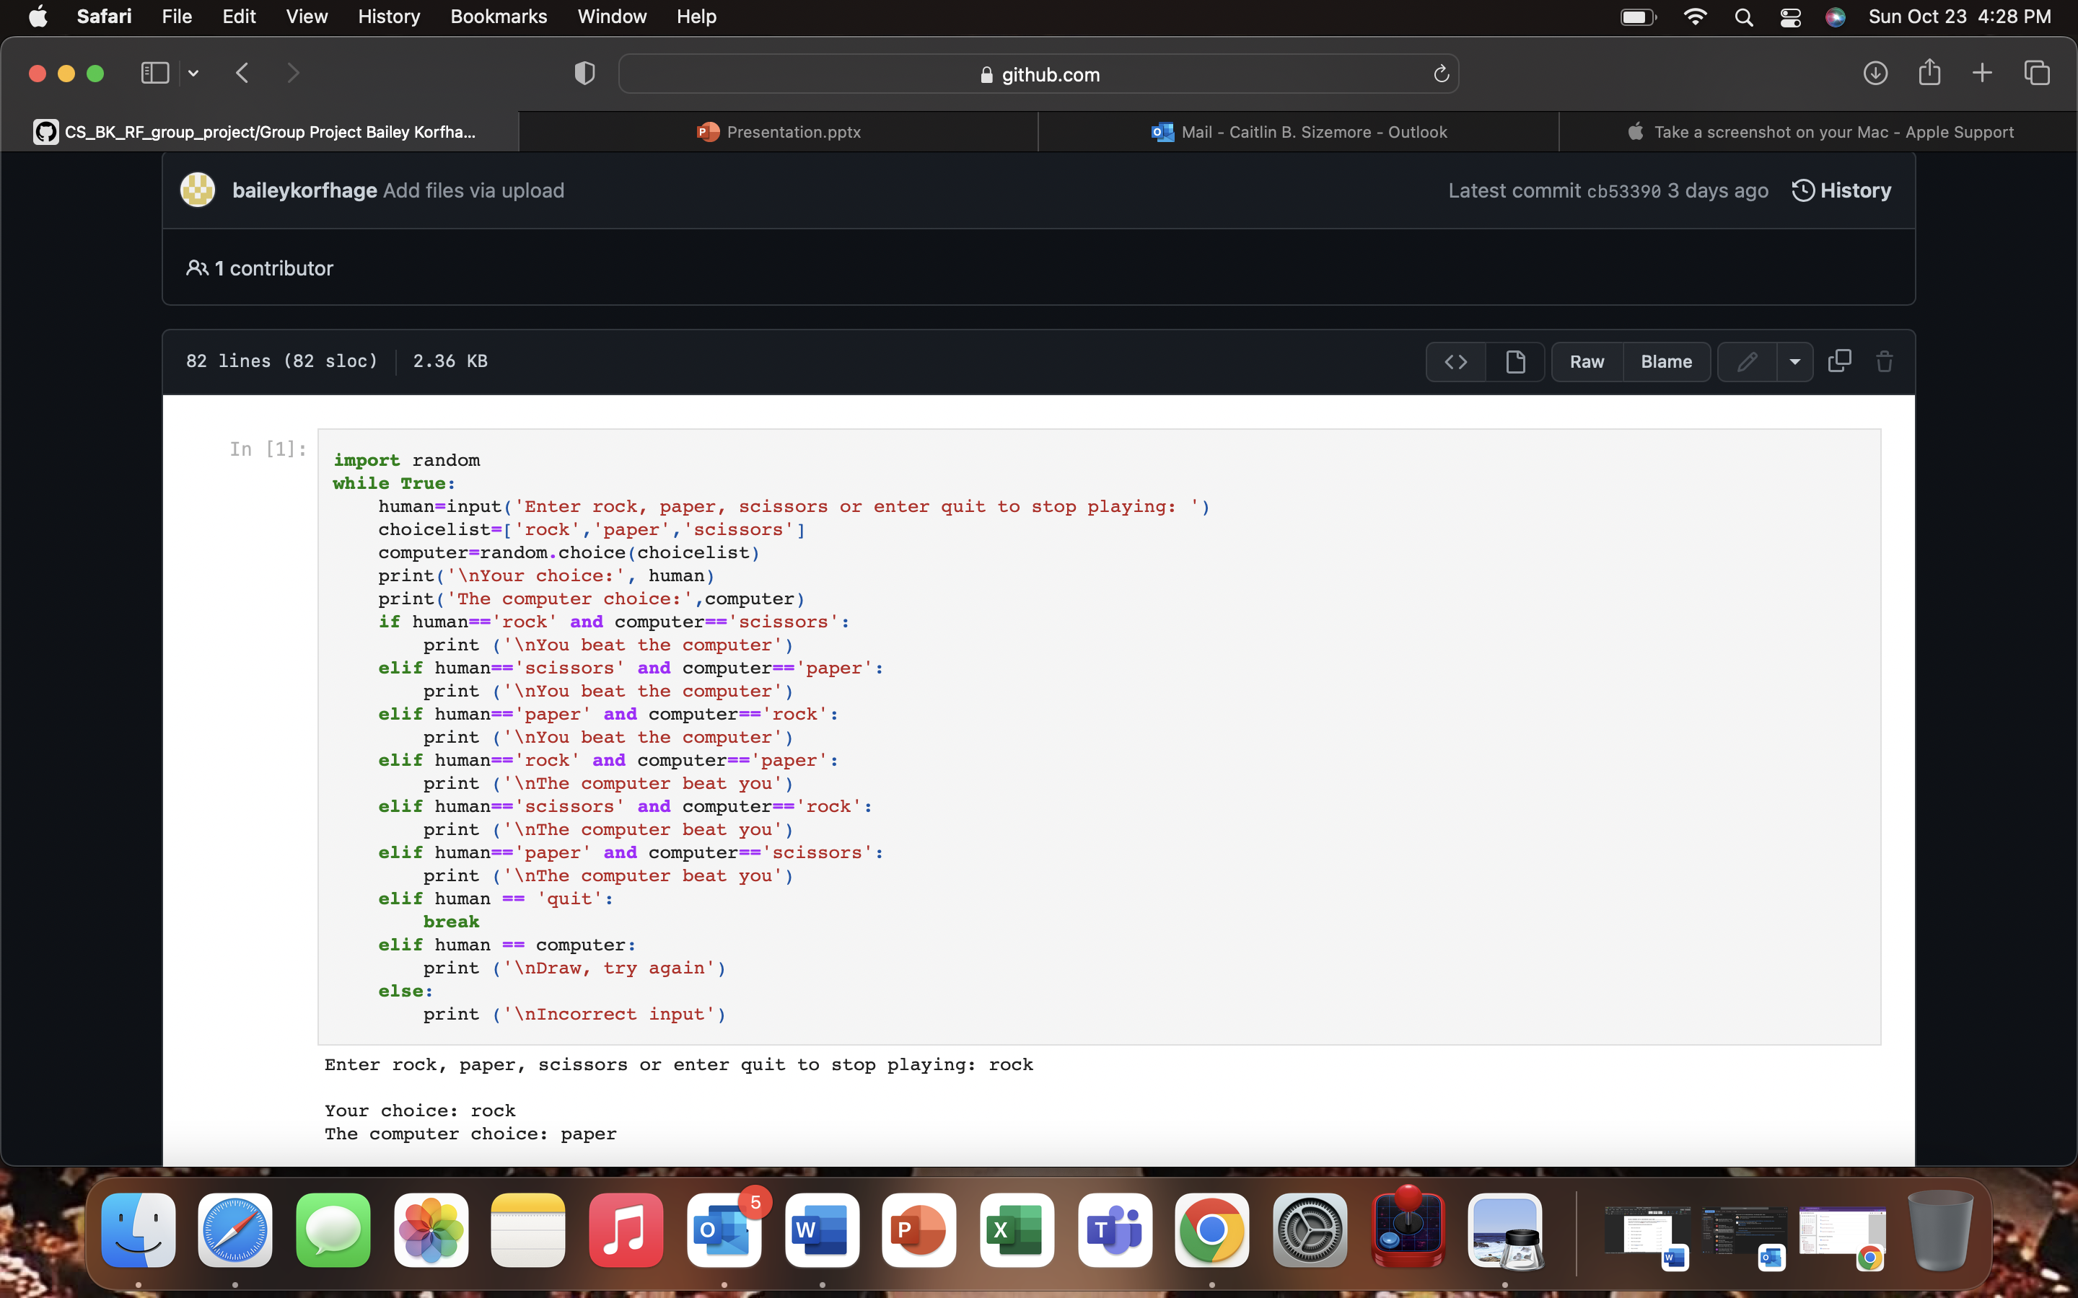

While Loop/Inputs
Import random: allows randomization in the computer's choice
While loop: allows user to keep playing while True
human: player chooses input
choicelist: list of options for computer's choice
computer: computer chooses random option from choicelist
Incorporates random function
print: prints user and computer choice

Slide 3
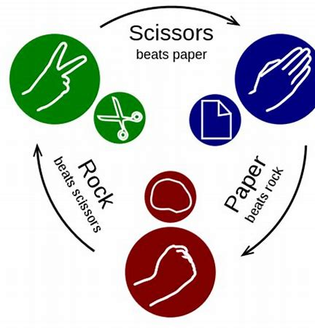
Conditional Statements
The IF statements are what makes the game work
These condition checks allow for the game to be won, lost, or tied.
Rock>scissors>paper>rock
When choices are the same, “Draw is displayed.” The while loop allows for two new choices to be played.
Else: incorrect input, allows the game to repeat if the user does not use a proper input

Slide 4
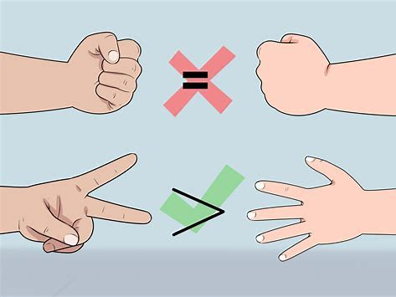
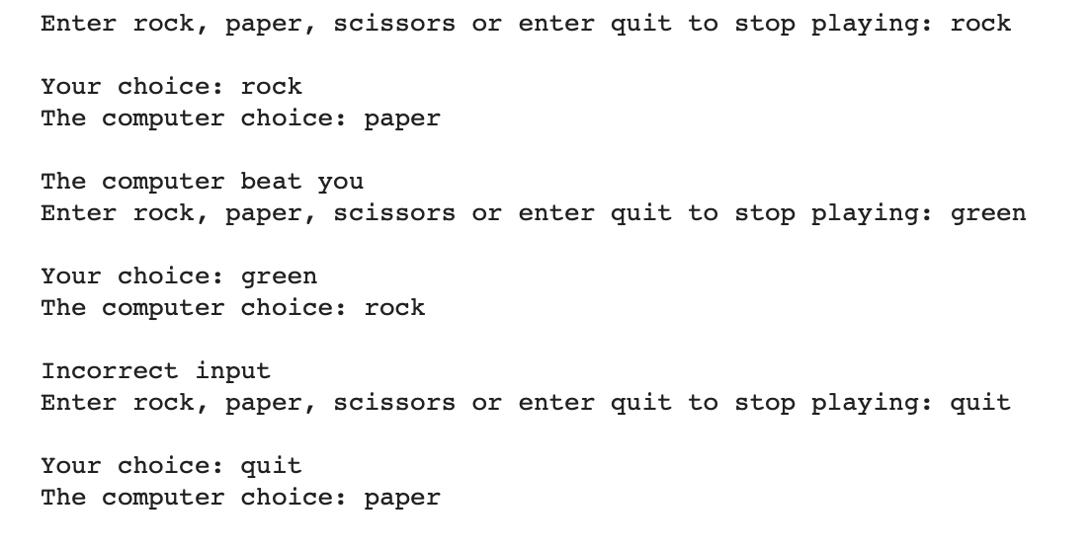
Outcomes
Outcomes are provided through condition checks of user input
"The computer beat you"
"Incorrect input"
Quit
Continuation of play – while loop

